Slide 1
Task 6.5 Optimal VPP configuration and Consumer-Centric Demand Response Optimization Module (FLEXopt)
Important functionalities:
Provide optimal VPP configuration according to flexibility requests from third parties.
Allow proper segmentation, classification and clustering of flexibility assets.
Building managers/prosumers increase their level of insight into their flexibility assets portfolio and flexibility = Providing better insight into technical flexibility operation space boundaries
FLEXopt
Aggregator
Analytics
Optimization: VPP configuration of flexibility
Meets the requests of the DSO
BEYOND
platform
Building manager
Passive role
Analytics of the building flexibility portfolio
Analytics of flexibility activation
PEASH App

Slide 2
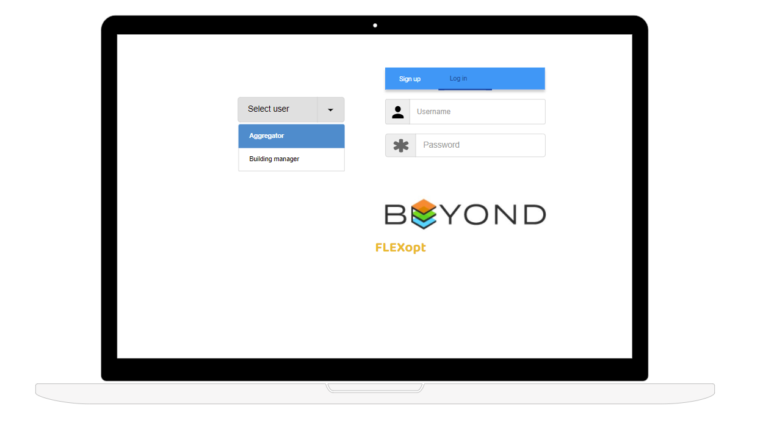
Task 6.5 Optimal VPP configuration and Consumer-Centric Demand Response Optimization Module (FLEXopt)

Slide 3
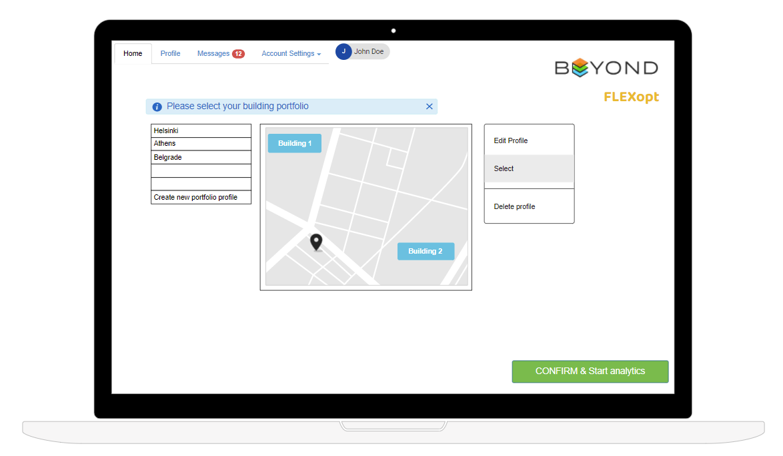
Task 6.5 Optimal VPP configuration and Consumer-Centric Demand Response Optimization Module (FLEXopt)

Slide 4
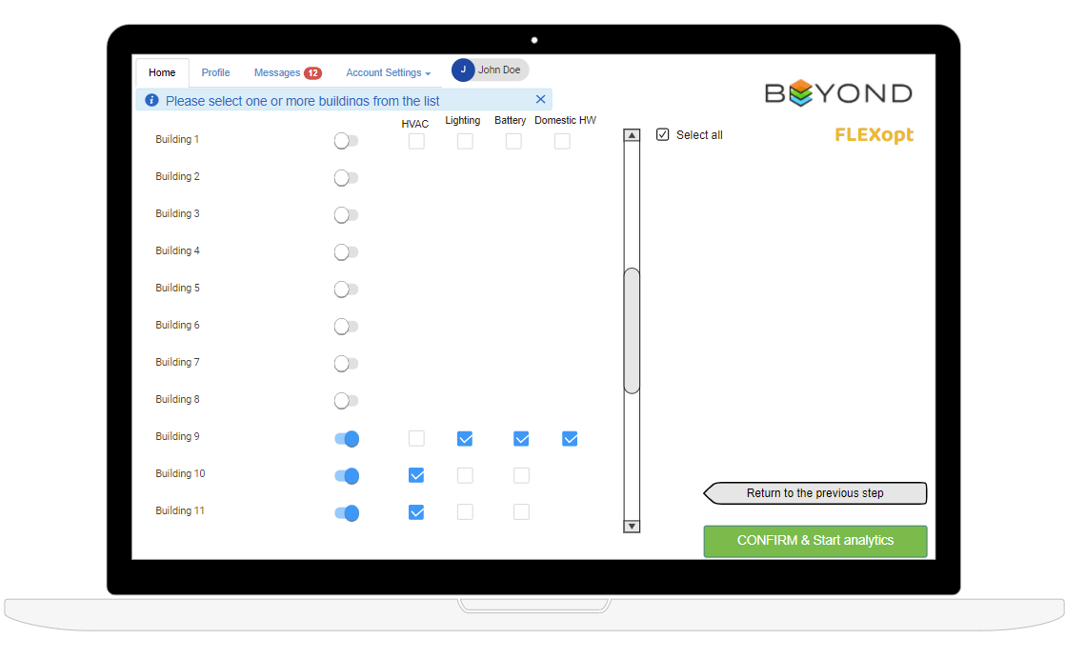
Task 6.5 Optimal VPP configuration and Consumer-Centric Demand Response Optimization Module (FLEXopt)

Slide 5
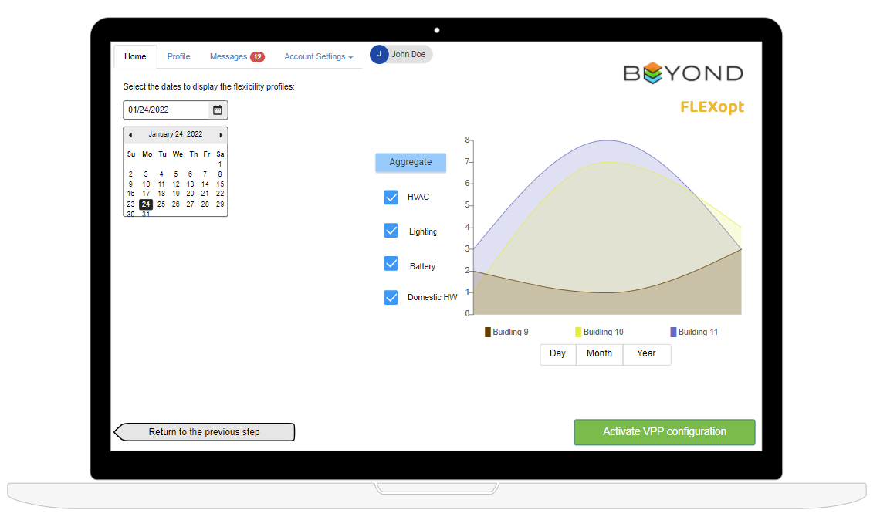
Task 6.5 Optimal VPP configuration and Consumer-Centric Demand Response Optimization Module (FLEXopt)

Slide 6
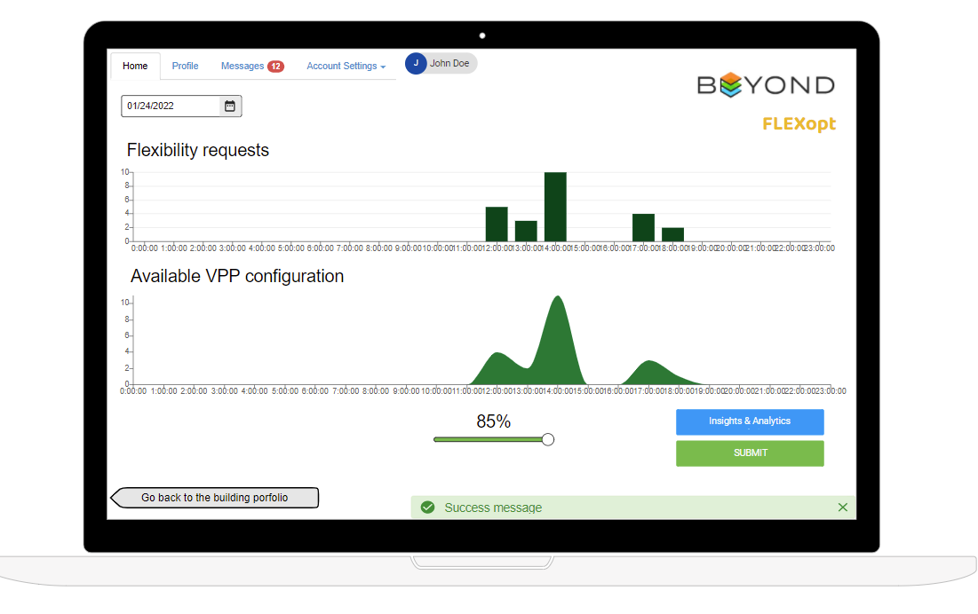
Task 6.5 Optimal VPP configuration and Consumer-Centric Demand Response Optimization Module (FLEXopt)

Slide 7
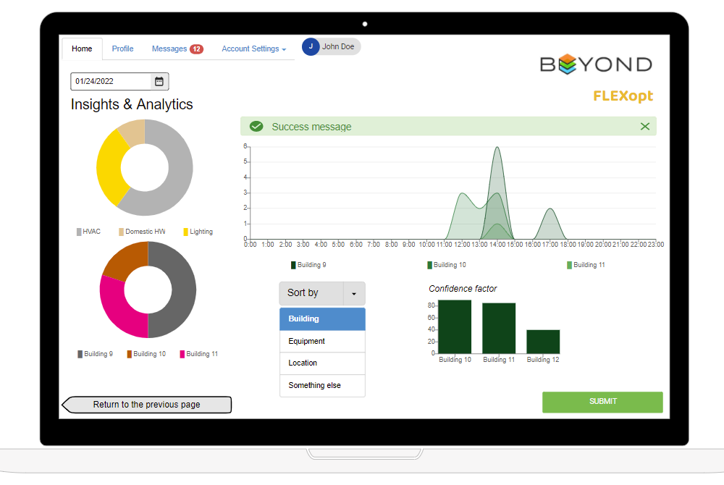
Task 6.5 Optimal VPP configuration and Consumer-Centric Demand Response Optimization Module (FLEXopt)

